Slide 1
Chapter 8 – Naïve Bayes
Data Mining for Business Analytics
Concepts, Techniques and Applications with JMP Pro
Shmueli, Bruce, Stephens & Patel
© Galit Shmueli, Peter Bruce and Mia Stephens 2016

Slide 2
Characteristics
Data-driven, not model-driven
Makes no assumptions about the data

Slide 3
Naïve Bayes: The Basic Idea
For a given new record to be classified:
Find other records like it (i.e., same values for the predictors)
Identify the prevalent class among those records
Assign that class to your new record

Slide 4
Usage
Requires categorical variables
Numerical variable must be binned and converted to categorical
Can be used with very large data sets
Example: Spell check programs assign your misspelled word to an established “class” (i.e., correctly spelled word)
(JMP allows continuous variables)

Slide 5
Exact Bayes Classifier
Relies on finding other records that share same predictor values as record-to-be-classified.
Want to find “probability of belonging to class C, given specified values of predictors.”
Even with large data sets, may be hard to find other records that exactly match your record, in terms of predictor values.

Slide 6
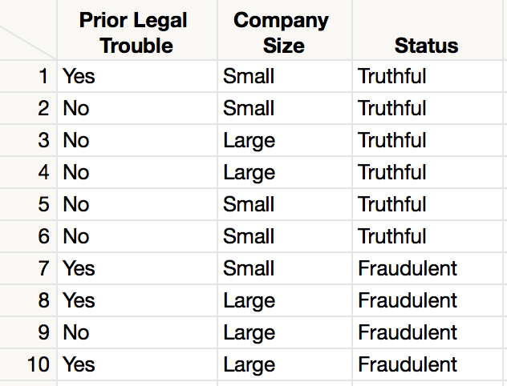
Example: Financial Fraud
Target variable:
Audit finds fraud, no fraud
Predictors:
Prior pending legal charges (yes/no)
Size of firm (small/large)

Slide 7
Exact Bayes Calculations
Goal: classify (as “fraudulent” or as “truthful”) a small firm with charges filed
There are 2 firms like that, one fraudulent and the other truthful
P(fraud | charges=y, size=small) = ½ = 0.50
Note: calculation is limited to the two firms matching those characteristics

Slide 8
Solution – Naïve Bayes
Assume independence of predictor variables (within each class)
Use multiplication rule
Find same probability that record belongs to class C, given predictor values, without limiting calculation to records that share all those same values

Slide 9
Naïve Bayes Procedure
Take a record, and note its predictor values:
Find the probabilities those predictor values occur across all records in C1
Multiply them together, then by the proportion of records belonging to C1
Repeat steps 1 and 2 for each class
The probability of belonging to C1 is value from step (3) divide by sum of all such values C1 … Cn
Establish and adjust a “cutoff” prob. for class of interest

Slide 10
Naïve Bayes Calculations
Goal: classify (as “fraudulent” or as “truthful”) a small firm with charges filed
Conditional Probabilities of Class 1 (fraudulent):
  Proportion of “yes” among frauds = 3/4
  Proportion of “small” among frauds = 1/4
  Proportion of frauds in full data = 4/10
  3/4 * 1/4 * 4/10 = 0.075
Conditional Probabilities of Class 2 (truthful):
  Prop “charges = y” among truthfuls, times prop. “small” among truthfuls, times proportion truthfuls = 1/6 * 4/6 * 6/10 = 0.067
P(fraud | charges, small) = 0.075/(0.075+0.067)
= 0.53

Slide 11
Naïve Bayes, continued
Note that probability estimate does not differ greatly from exact
All records are used in calculations, not just those matching predictor values
This makes calculations practical in most circumstances
Relies on assumption of independence between predictor variables within each class

Slide 12
Independence Assumption
Not strictly justified (variables often correlated with one another)
Often “good enough”

Slide 13
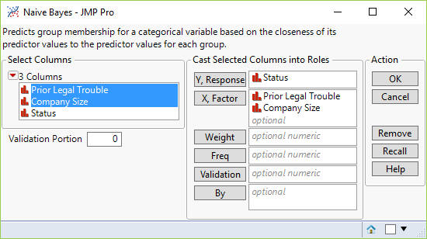
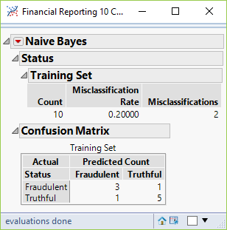
Naïve Bayes in JMP

Slide 14
Naïve Bayes Advantages
Handles purely categorical data well
Works well with very large data sets
Simple and computationally efficient

Slide 15
Naïve Bayes Shortcomings
Requires large number of records
Problematic when a predictor category is not present in training data
  Assigns 0 probability of response, ignoring information in other variables

Slide 16
On the other hand…
Probability rankings are more accurate than the actual probability estimates
  Good for applications using lift (e.g. response to mailing), less so for applications requiring probabilities (e.g. credit scoring)

Slide 17
Summary
No statistical models involved
Naïve Bayes (like KNN) pays attention to complex interactions and local structure
Computational challenges remain (but JMP takes a short cut)

